Slide 1
Sentiment Analysis of Covid-19 Tweets-Visualization Dashboard
By Team- RINJ

Slide 2
Introduction
2020 saw a new virus namely Corona Virus which affected millions of people all over the world.
WHO Declared the spread of Corona Virus as a Pandemic.
Almost every country in the world was locked down to prevent the spread of this virus.
This pandemic made people make use of social media to share their emotions over various issues happening all over the world.
We have made a Model which predicts the sentiments of the tweets that are inputted.
Based on this results authority can take the proper and important steps.

Slide 3
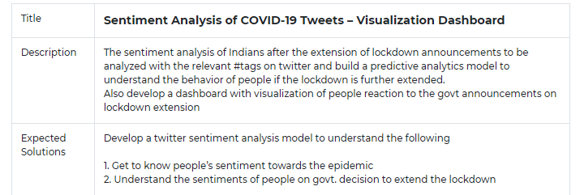
Problem Statement

Slide 4
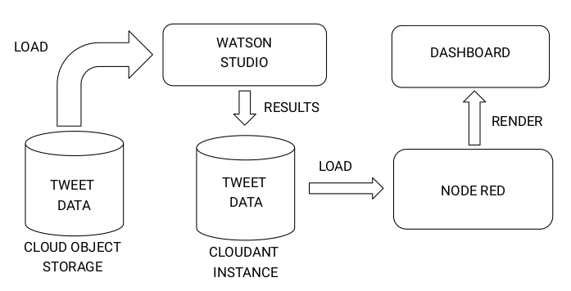
Flowchart

Slide 5
Applications
The predictive analysis provided by our model can help recognize the sentiments and views of the masses on important news like extension of lockdown or easiness and sectors now allowed to function and these sentiments then further help the manufacturers/service providers predict about the demand/supply chain.
If the people are unhappy about any decisions taken by the authorities then they would react negatively of the same and our model will bring the same on to notice and then authorities could think about the matter once again

Slide 6
Advantages
We have an interactive dashboard for visualizing the analysed data.
The same project can be run on a different situation to analyse the sentiments of people with just changing the input dataset.
The result of the project is quite lightweight and the dashboard hardly uses any computation.

Slide 7
Future Scope
We can provide user with a choice to scrape and predict tweet from desired date
We can add geolocation feature which will scrape tweets and predict sentiments from a specified location and graph of same will be plotted
We can make an app of the same for mobile devices
Extensions for browsers can also be made which will predict and show sentiments next to tweets on twitter page

Slide 8
THANK YOU!

